Slide 1

Application of Factorial Design in Soil Field Capacity
Eric Agyemang
MAT 458

Slide 2

Outline
Problem Background
Purpose of Project
Methods
Results
Conclusion and Suggestions

Slide 3
Problem Background
Corn is the most grown crop in the world
The United States Department of Agriculture conducted experiment to test water efficiency on maize cultivation.
Site of experiment was Northeast Colorado at the Limited Irrigation Research Facility (LIRF)
Conducted at 9x40 meters
Tested crop yield at different water irrigation requirements
Collected data on soil field capacity

Slide 4
Purpose of Project
Test for differences in Soil Capacity with respect to Water Irrigation and Soil Depth
Test individual treatment combinations
Data Collected from the USDA database
Four plots per treatment combination
Six water treatment levels
Seven soil depth levels
Total of 168 observations

Slide 5
Methods
There are two factors that we consider
Water irrigation requirements
Soil depth
Water irrigation requirements
Six levels
T1 (Control): 100 % water requirement
T2: 85% of water requirements
T3: 75% of water requirements
T4: 70% of water requirements
T5: 55% of water requirements
T6: 40% of water requirements

Slide 6
Methods
Soil Depth Requirements
Seven levels
1: (0-15 cm)
2: (15-45 cm)
3: (45-75 cm)
4: (75-105 cm)
5: (105-135 cm)
6: (135-165 cm)
7: (165-200 cm)

Slide 7

Methods
Used Two-factor Factorial Design
Model
$y_{ijk}=μ+τ_{i}+β_{j}+{\left(τβ\right)}_{ij}+ε_{ijk}$
Where $τ_{i}$ is the effect of the $i^{th}$ level of water irrigation factor
$β_{j}$ is the effect of the $j^{th}$ level of soil depth
${\left(τβ\right)}_{ij}$ is the interaction
Fixed Effects Model
Hypothesis test
$H_{0}:τ_{1}=…=τ_{6}=0 vs H_{a}:τ_{i}≠0$ for some $i$
$H_{0}:β_{1}=…−β_{7}=0 vs H_{a}:β_{j}≠0$ for some $j$
$H_{0}:{\left(τβ\right)}_{ij}=0$ for all $i,j vs$ $H_{a}:$ at least one ${\left(τβ\right)}_{ij}≠0$

Slide 8
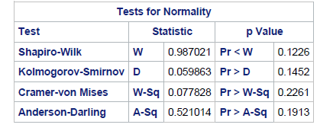
Test for Normality

Slide 9
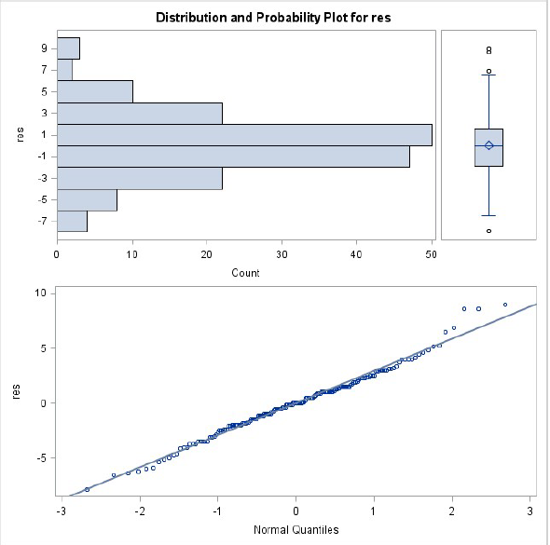
Test For Normality

Slide 10
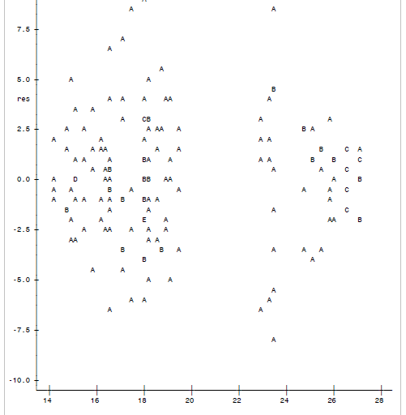
Test for Equal Variance
Res*ypred

Slide 11
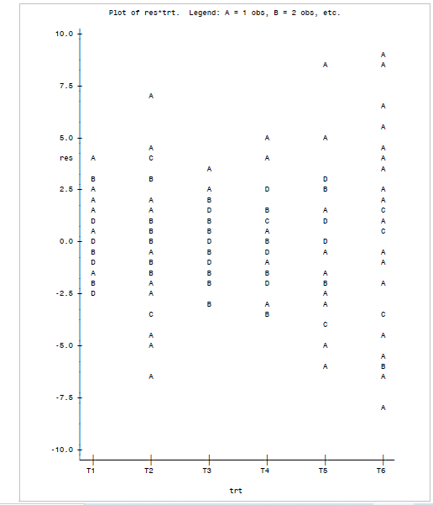
Test for Equal Variance

Slide 12
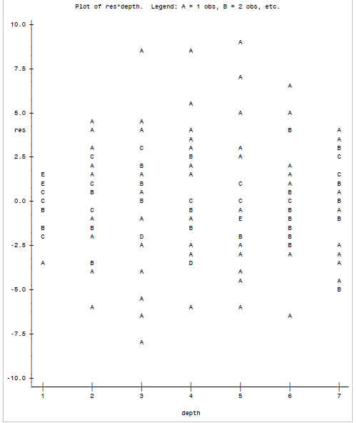
Test for Equal Variance

Slide 13
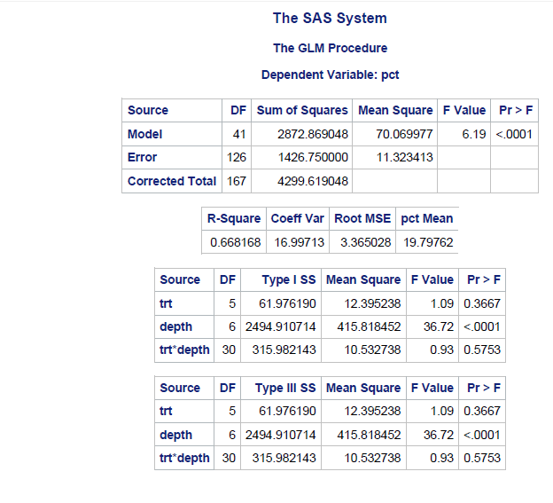
Results

Slide 14
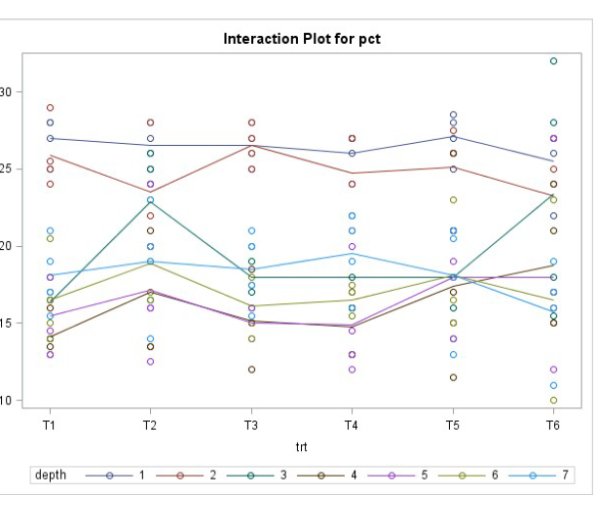
Results

Slide 15
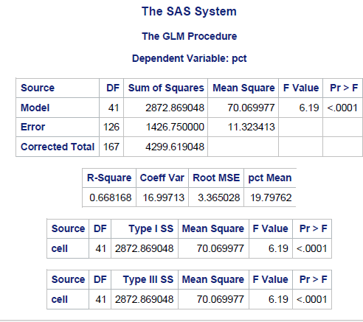
Results

Slide 16
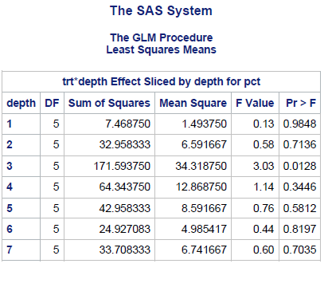
Results

Slide 17
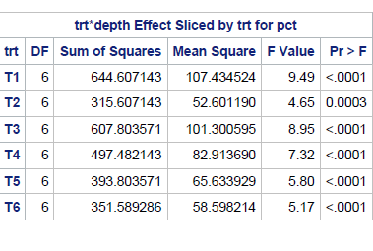
Results

Slide 18
Implications
Maize is a shallow crop that best grows between 3.81 – 6.35 cm.
The soil plots with shallow depth have higher field capacity opposed to plots with deeper depth.
Shallow plots provide more water for maize plots to grow.
It is already known that higher water irrigation produces higher maize crop yield.
Future research on this site should be conducted to explore the relationship between soil depth and maize crop yield.

Slide 19
Sources
Kirkham, M.B. “Field Capacity, Wilting Point, Available Water, and the Non-Limiting Water Range.” Principles of Soil and Plant Water Relations, Academic Press, 9 May 2007, www.sciencedirect.com/science/article/pii/B9780124097513500086.
“Optimum Corn Planting Depth.” Optimum Corn Planting Depth - "Don't Plant Your Corn Too Shallow" // Integrated Crop and Pest Management News Article // Integrated Pest Management, University of Missouri, University of Missouri, 6 Apr. 2016, ipm.missouri.edu/IPCM/2016/4/Optimum_Corn_Planting_Depth-Dont_Plant_Your_Corn_Too_Shallow/.
Trout, Thomas J., and Walter C. Bausch. “USDA-ARS Colorado Maize Water Productivity Data Set.” Irrigation Science, vol. 35, no. 3, 2017, pp. 241–249., doi:10.1007/s00271-017-0537-9.

